Slide 1
Office365 Security
Ried im Innkreis, 10.03.2020
Florian Adelberger

Slide 2
Lösungen
Azure AD
MFA
Conditional Access Policy
Device Compliance
Intune
Cloud App Security
Windows Security Center

Slide 3
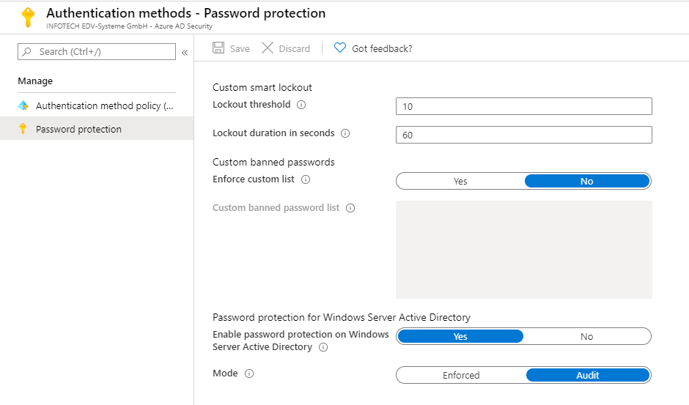
Azure AD
Password protection Policys

Slide 4
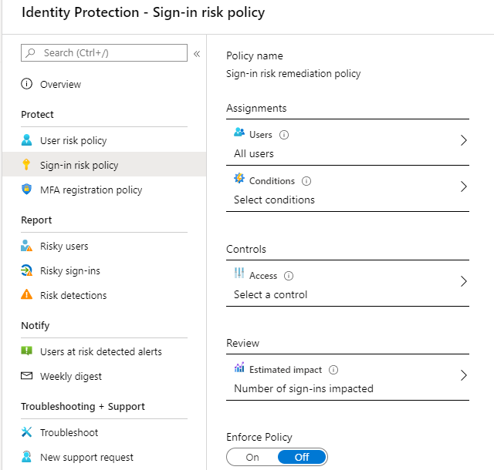
Azure AD
Identity Protection

Slide 5
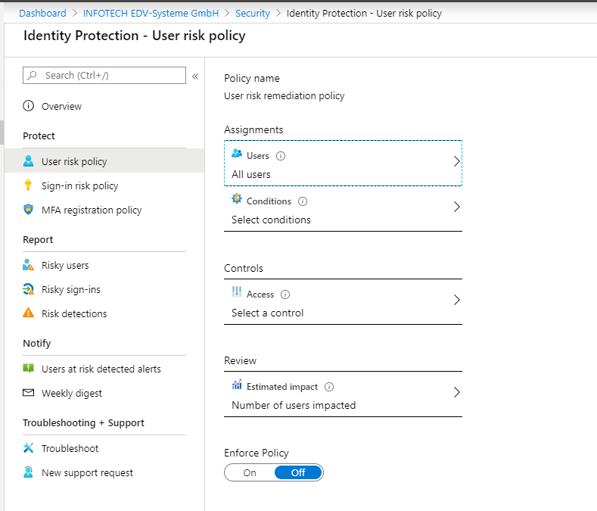
Azure AD
User Risk / Sign In Risk Policy

Slide 6
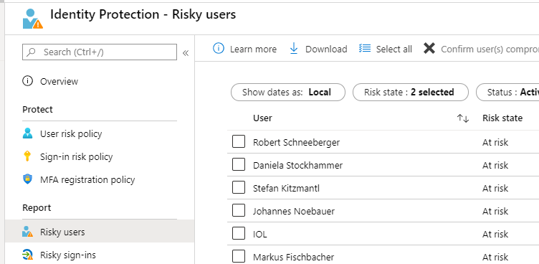
Azure AD
Reports Risky Users

Slide 7
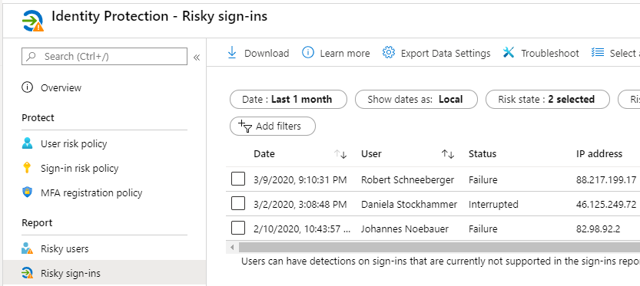
Azure AD
Reports Risky Sign-Ins

Slide 8
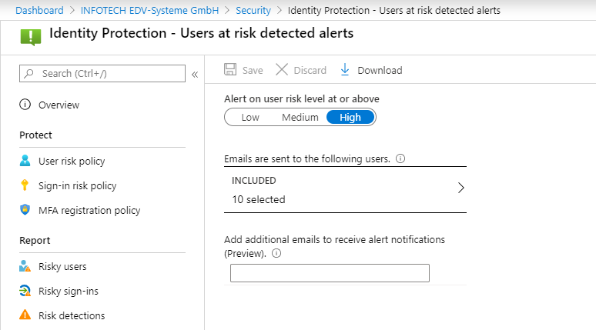
Azure AD
User Risk Alerts

Slide 9
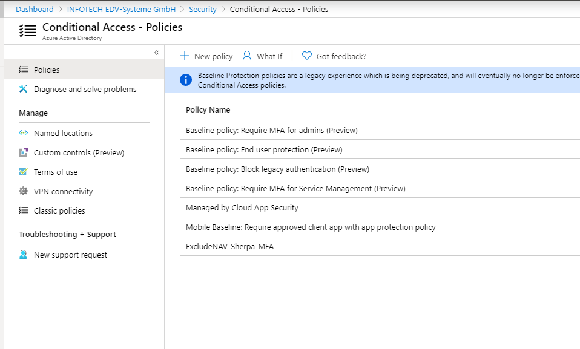
Azure AD
Conditional Access Policy

Slide 10
Azure AD
Conditional Access Policy

Slide 11
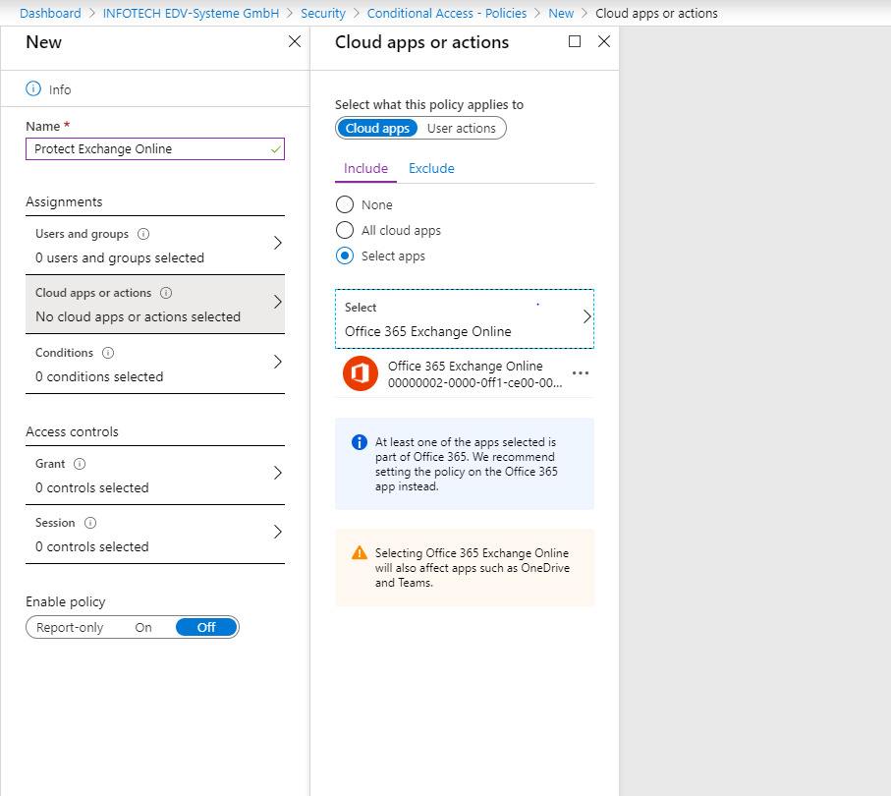
Azure AD
Conditional Access Policy

Slide 12
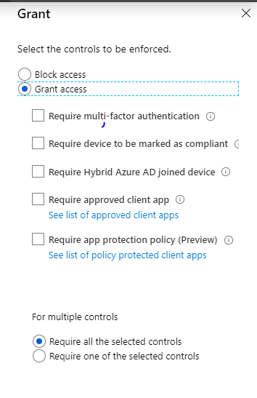
Azure AD
Conditional Access Policy

Slide 13
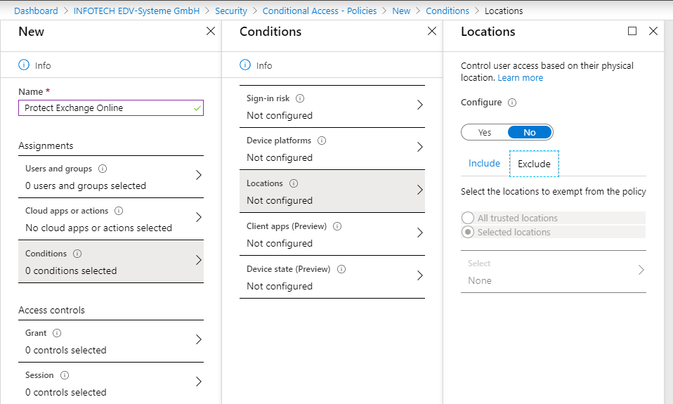
Azure AD
Conditional Access Policy
Notes:
Ausnahmen für bestimmte Locations (Pulbic IP Adresse)

Slide 14
Azure AD Devices
Wer kann Geräte in Azure AD einbinden?
Einschränkung Azure AD Join nur für bestimmte User
Azure AD Hybrid Join
Azure AD Join mit Autopilot

Slide 15
Device Compliance Azure AD/ Intune

Slide 16
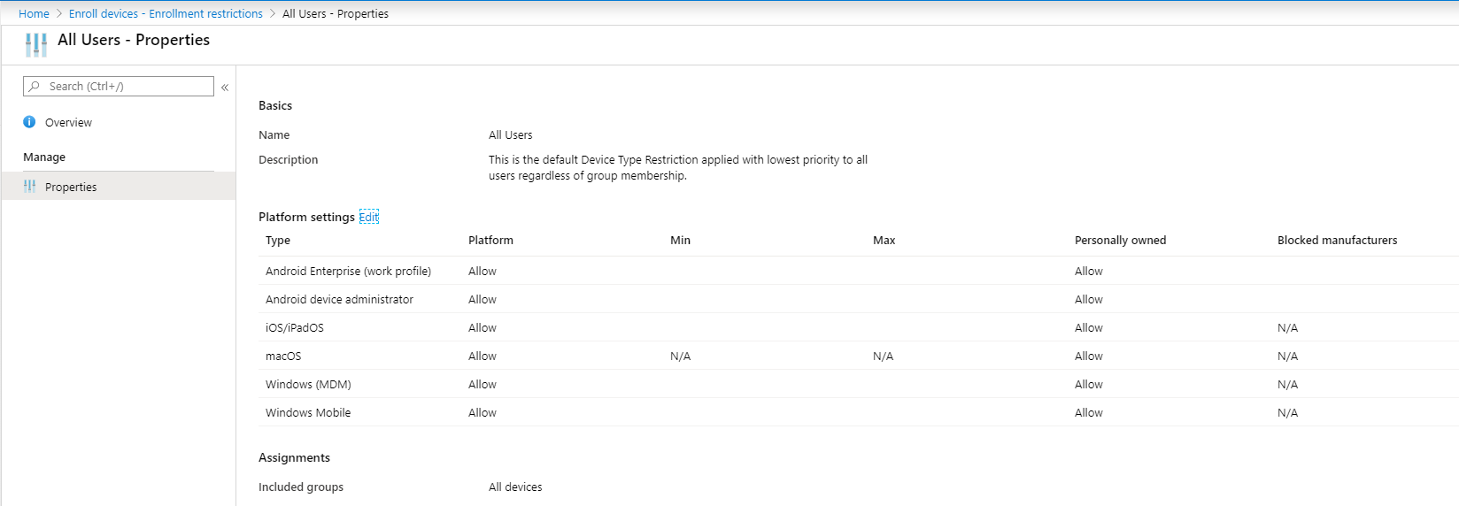
Azure AD
Intune Device Enrollment restrictions

Slide 17
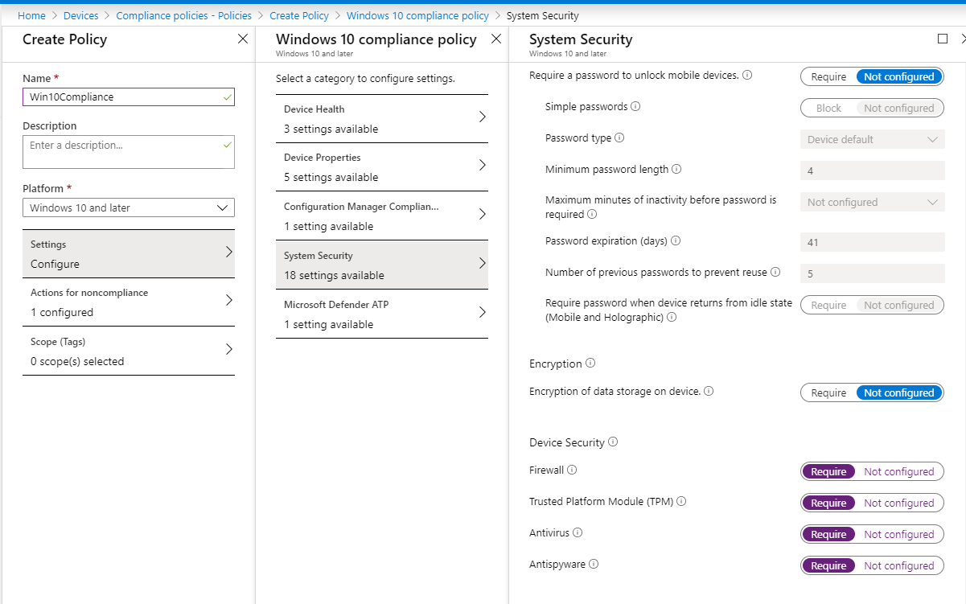
Device Compliance Azure AD/ Intune
Compliance Policy

Slide 18
Cloud APP Security
Finden und Kontrolle von verwendeten APPs (Shadow IT)
Schutz von Daten und Zugriffen in der Cloud
Schutz vor Ransomware / Auffälliges Verhalten

Slide 19
Demos
Intune
Compliance Policy
Azure AD
Conditional Access
Cloud APP Security
Anbindung der Cloud APPS
Defender Security Center
Onboarding Win10

Slide 20
Vielen Dank!

